Slide 1
CS487-Introduction to competitive programming: A2SV
Lecture #4: Sorting

Slide 2
What’s Sorting
Input: array A[1…n] of numbers.
Output: permutation B[1…n] of A such that B[1] ≤ B[2] ≤ … ≤ B[n]
e.g. A = [7, 2, 5, 5, 9.6] → B = [2, 5, 5, 7, 9.6]
How can we do it efficiently ?

Slide 3
Why Is Sorting Useful?
Obvious applications
Organize a library
Maintain a telephone directory
Problems that become easy once items are in sorted order
Find a median, or find closest pairs
Binary search, identify statistical outliers
Non-obvious applications
Data compression: sorting finds duplicates

Slide 4
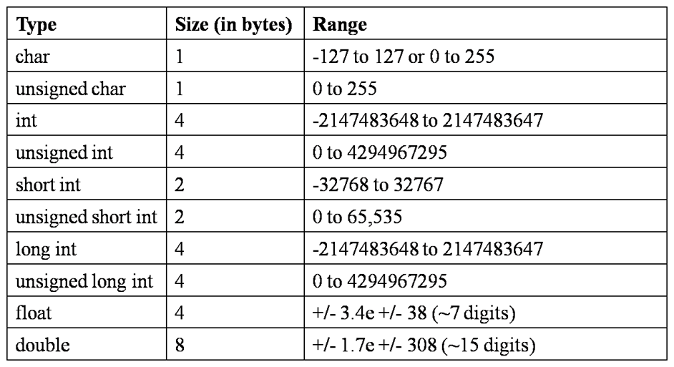
Stable? In-Place? Time-Complexity
A stable sorting algorithm will guarantee that if two elements "tie", then whichever element occurred first in the original array will also occur first in the sorted array
An in-place sorting algorithm does not require any extra memory

Slide 5
Insertion Sort
Let’s sort the beginning of the list, and insert new elements to the sorted part one by one.

Slide 6
Selection Sort
For each spot starting from the beginning, let’s find the right element for this spot

Slide 7
Merge Sort
Divide and conquer:
1- Let the first half of the array be sorted
2- Let the second half of the array be sorted
3- Let’s merge them together
Base case?

Slide 8
Quick Sort
Let’s pick a pivot
Let’s put all the elements that are smaller, to the left of the pivot.
Let’s put all the elements that are greater, to the right of the pivot.
Let the left side be sorted
Let the right side be sorted
Base case?

Slide 9
Programming exercises
Insertion sort
Selection sort
Merge sort
Quick sort
Input: Numbers from 1 to 10000 in a random order (you can write a program to generate the input)
Output: 1 2 3 … 10000

Slide 10
Environment Practice -LEETCODE
Two sum
Add two numbers
Reverse integer

Slide 11
Counting Sort
If the range of the numbers is small enough that can fit in memory;
1- Initialize counter array with 0, its size is the range of the numbers
2- Iterate over the numbers, update corresponding counter for each of them
(choose a or be for step 3)
3a- Generate output based on counts in counter array if sorting only numbers
3b- Accumulate counter values, place input into output based on counter values

Slide 12
Radix Sort
If the number of digits of numbers are small enough
1- Do following for each digit d from least significant to most significant
a) Sort input array using counting sort (or any stable sort) according to the i’th digit

Slide 13
Efficient Randomization
Let’s say we want to have each number from 1 to N in a random order.
1- Do following for each position from N-1 to 1
a) Generate a random number rn between 0 and pos-1
b) Swap elements in rn and pos

Slide 14
Sorting Practice -LEETCODE
Sort array by party ii

Slide 15
Quote of the day
“Amateurs practice till they get it right; professionals practice till they can’t get it wrong.”

